Slide 1
Water Runner Simulation
Nitish Thatte
nitisht

Slide 2
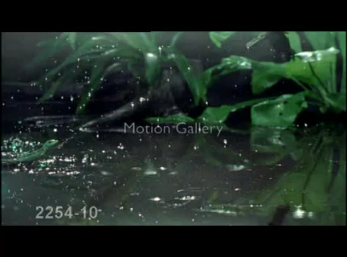

Slide 3
Water Running
Force generated from fluid drag [2]
Must withdraw foot form air cavity before
collapses [1]
Air Cavity
Water

Slide 4
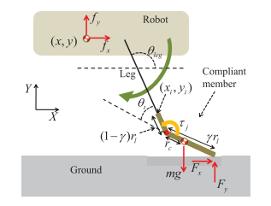
Hard Ground
Foot deflection dynamics [1]
Ground contact model

Slide 5


Slide 9
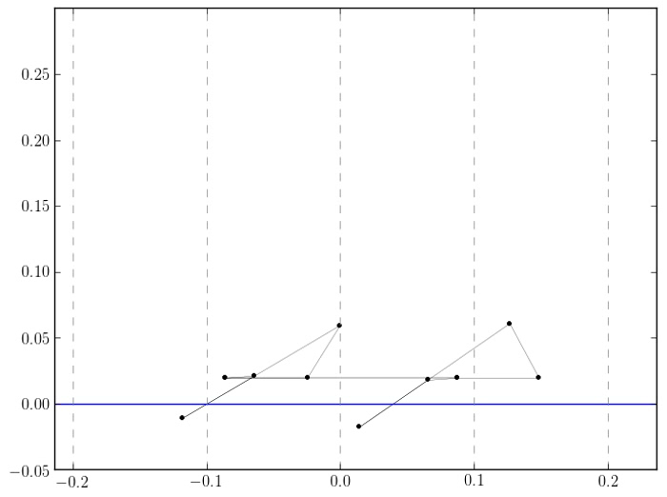

Slide 10
Numerical Issues
Problems
Solutions
Ground contact discontinuity → Stiff system
Adaptive time steps
Different time scales
Multi-rate method
Even Better: Use Implicit Method

Slide 11
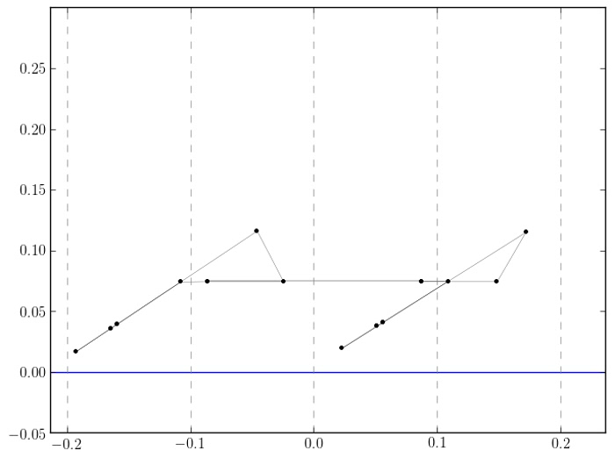

Slide 12
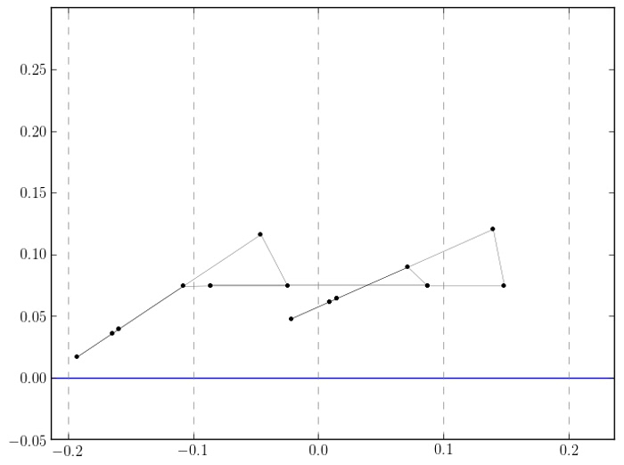

Slide 13
Questions?
References
Steven Floyd and Metin Sitti. Design and development of the lifting and propulsion mechanism for a biologically inspired water runner robot. Robotics, IEEE Transactions on, 24(3):698–709, 2008.
JW Glasheen and TA McMahon. Vertical water entry of disks at low Froude numbers. Physics of Fluids, 8(8):0–5, 1996.
HS Park and Metin Sitti. Compliant footpad design analysis for a bio-inspired quadruped amphibious robot. Intelligent Robots and Systems, 2009. IROS . . . , pages 1–11, 2009.

